Slide 1
Text Sentiment Analysis on IMDB Reviews

Slide 2

Motivation
The need to “speak computer” is no longer a barrier to leveraging machines. For the first time in history, we are able to communicate with computers in the same way we speak to each other. Gone are the days of relying on keywords and specific syntax designed to activate an algorithm. We can talk to virtual assistants in our phones, receive curated purchasing advice from chatbots, and let autocomplete features assist with our searches, write our emails, and ask our questions. All of these are examples of Natural Language Processing (NLP) in action.
When talking about NLP, Sentiment analysis comes in handy. It extracts useful information and patterns to predict behavior of developments and events taking place in social media. The different types of social media include various social networking pages, blogs, video sharing pages and company networks such as Facebook, Twitter, Instagram , email interactions in a system review sites like IMDB. The prediction and analysis of information that these domains offers us ,includes multiple application areas such as marketing, economics, politics and health.

Slide 3
This Project
Exploratory Data Analysis
Having a look on our dataset
Text Preprocessing
Cleaning our dataset
Data Transformation
Transforming our data for our model
Model Building
Architectural desing of our Neural Network
Prediction on
Reviews
Random Reviews Prediction
Prediction on
Toy Reviews
Prediction on our own sentences

Slide 4
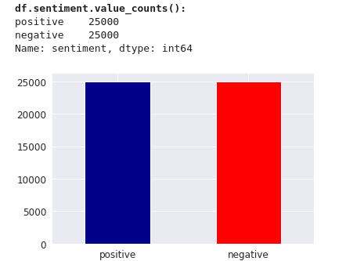
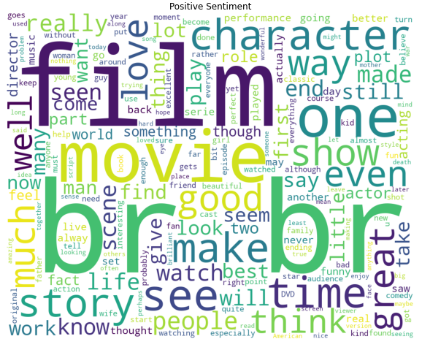
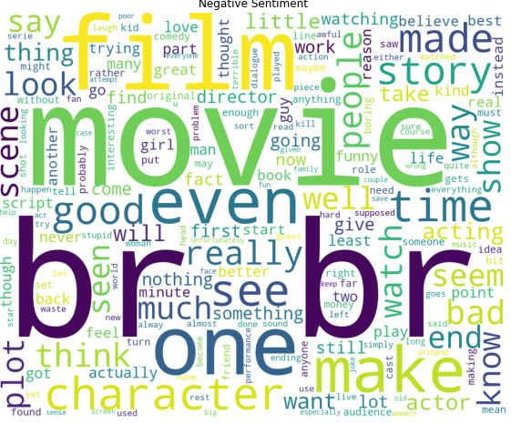
The dataset
The IMDB dataset consists of 50.000 reviews that have been divided into ½ of positive reviews and ½ of negative reviews,
with zero null values.
Considering the vocabulary used in this reviews we can actually visualize the words used for each of positive and negative reviews with the help of WordCloud. Moreover , we transform each Positive and Negative review into 1 and 0.

Slide 5
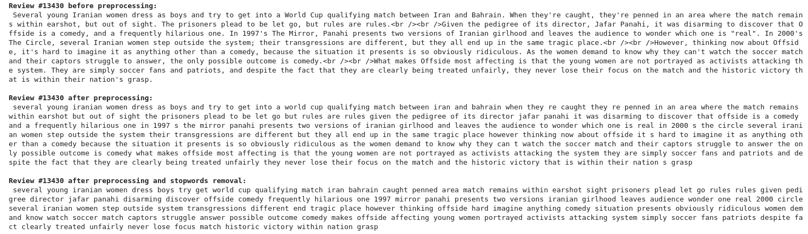
Data Preprocessing
Data pre-processing is done to eliminate incomplete, noisy or inconsistent information. It is an important and mandatory step, which is performed first when using any of the algorithms that exist in both NN and ML. To extract the useful information from a text it is critical to remove some of the building blocks of a this text. These are the:
1.punctuation removal 2.HTML tags removal
3.URL's removal 4.removal of characters which are not letters or digits
5.removal of successive whitespaces 6.transformation of the text to lower case
7.whitespaces strip from the beginning and the end of the reviews.
Let’s see an example of this process.

Slide 6
Data Transformation
Tokenization is the process of breaking a stream of text into words, phrases, symbols,or other meaningful elements called tokens. The aim of the tokenization is the exploration of the words in a sentence. The list of tokens becomes input for furtherprocessing such as parsing or text mining
Afterwards, We use the texts_to_sequences() function of the Tokenizer class to convert the training reviews and test reviews to lists of sequences of integers (tokens) .
The variable lengths of the input sequence of data need to be converted to an equal length format. This task is achieved using masking or embeddings and padding in Keras or TensorFlow. Padding reshapes the variable length input sequence to sequence of the same length. However, the padded sequences won’t be used to train the model. That’s why we use the Embeddings which can be thought of as an alternate to one-hot encoding along with dimensionality reduction.

Slide 7
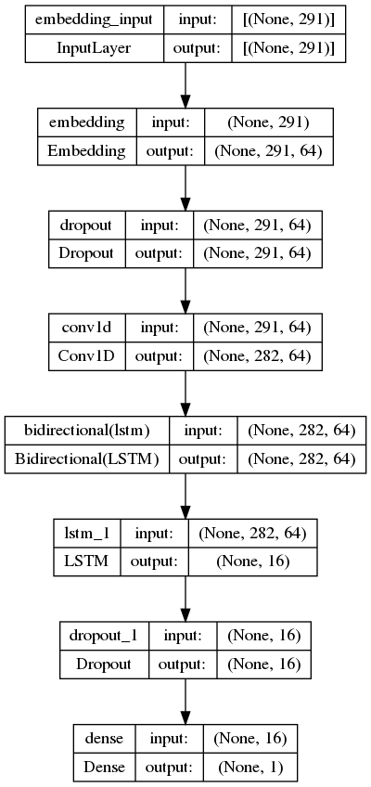
Neural Network Architecture
After a lot of experimentation with various layers and parameters we have concluded into a model that consists of one Embedding Layer, one Conv1D layer and two LSTM layers. We also have added two Dropout layers in order to reduce the overfitting that was observed during the training phase, these Dropout layers were inserted since the validation loss of our model was diverging from the loss in our training set.
In the training phase we get our model to train in five epochs. A valuable tool while training a neural network is callbacks. Callbacks are helpful as they stop our model when the validation accuracy of our model starts decreasing for consecutive 2 epochs as we’ll save the best possible weights which gives highest validation accuracy..

Slide 8
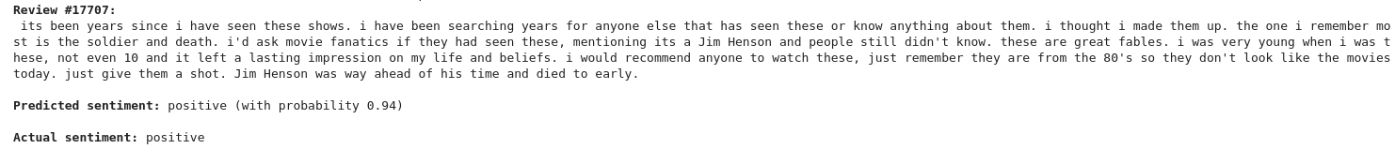
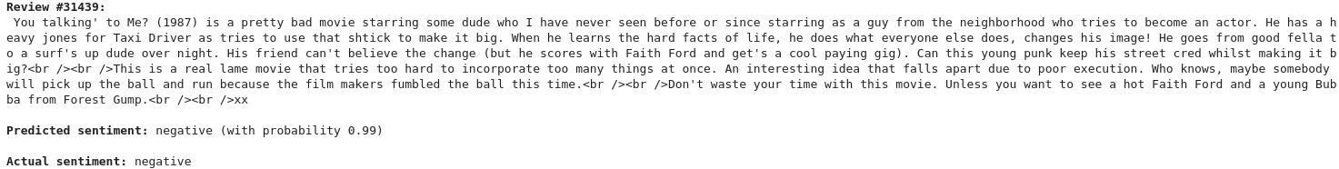
Results
Our model achieved 98% accuracy on the training set and 88% accuracy on the validation set. However, let’s now have our model predict some reviews from our dataset.
Even though there are not so many words that express “feeling” our model predicted correctly this review.
On the other hand, this review is harsh. Phrases like “lame movie” or “Don’t waste your time” make it easy for our model to predict that this review is negative.

Slide 9
Toy Reviews Evaluation
Last step it to test our model on reviews that were not in the dataset and that we created on our own.
A positive sentence
A negative sentence
A neutral sentence

Slide 10
Future Work
Multiple approaches could tackle the task of Sentiment Analysis. As we know machine learning models and neural networks don't take raw text data as an input. This means we must somehow encode our textual data to numeric values that our models can understand. There are many different ways of doing this like using the Bag of Words method. We could even use pretrained embeddings like GloVe Embeddings,which are a type of word embedding that encode the co-occurrence probability ratio between two words as vector differences.
Additionaly, there are plenty of ways to build our Neural Network, there is a large number of bibliography that suggest multiple architectures on how to build the desire Neural Model.
Moreover, another possible way of facing this problem would be to use a test set different from our training set, so, for example, we could have used the famous IMDB dataset in order to build our model and then we could implement our model having as a test set an irrelevant dataset . In this way, we could have seen the flaws that our model may have and built an even stronger one that predicts out of the box sentences.

Slide 11
Thanks!
Any questions?
Stasinos Panagiotis
(dit2123)

